Slide 1
ROS Messages
21AIE213 - Robot Operating System and Robot Simulation

Slide 2
Previous Section
ROS Topic Overview
Simple Example Overview
Publisher
Subscriber
Latched Topic

Slide 3
Section Overview
ROS Messages
Defining own Message
ROS Message Format
Compiling the message
Example Message Creation
Useful rosmsg commands
When Should You Make a New Message Type?

Slide 4
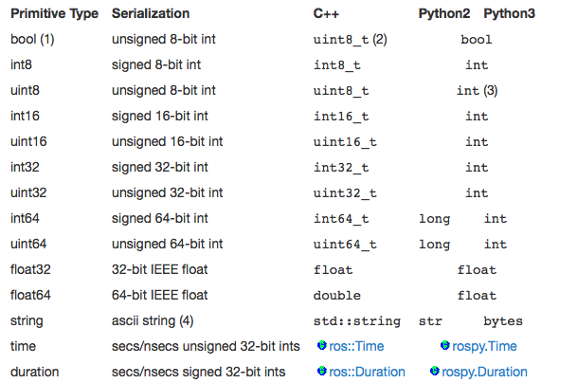
ROS Messages
ROS offers a rich set of built-in message types.
The std_msgs package defines the primitive types
Source: wiki.ros/msg

Slide 5
ROS Messages
These primitive types are used to build all of the messages used in ROS.
These messages are contained in the std_msgs package and the common_msgs package.
These message types are part of what gives ROS its power.
Since (most) laser range-finder sensors publish sensor_msgs/LaserScan messages, we can write control code for our robots without having to know the specific details of the laser range-finder hardware

Slide 6
Defining own Message
There are times when the built-in message types are not enough, and we have to define our own messages.
Five Steps to Define New ROS Message
1. Create a new folder named "msg" in root of the package
2. Inside msg folder create a new message file named "MessageName.msg"
3. Define the new message in the message file
4. Update CMakeList.txt and package.xml file to compile the new message into language-specific implementations
5. Build the package

Slide 7
ROS MessaGE Format
package_name/message_type
sdt_msgs/String
geometry_msgs/Twist

Slide 8
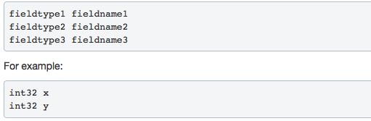
ROS Message Format

Slide 9

Compiling the message
Before compiling the new message, changes have to be made in CMakeList.txt and package.xml files to make catkin identify the new message
In package.xml file, add the below lines

Slide 10

COMPILING THE MESSAGE
In CMakeList.txt file do the following changes

Slide 11
Verifying the message
ros2 interface show package_name/msg/message_name : Shows contents of the message type
ros2 interface list : Will show the list of messages available in ROS
ros2 interface package package_name: Will list the messages defined in a particular package

Slide 12
Example Message Creation
A message to define a complex number
A complex number has two parts, real and imaginary. Both of which are floating point numbers.
The message definition of the new type is called as "Complex"
So the file Complex.msg will have the following contents
float32 real
float32 imaginary

Slide 13
EXAMPLE MESSAGE CREATION
Create a package named "complex_msg" and a sub directory named msg
Store the Complex.msg file in the msg directory.
Change the configuration files accordingly
Build the package
Create a package named "complex_talker_listener"
Change the talker.py node to publish random complex message of type "complex_msg/Complex"
Change the listener.py node to subscribe to complex message of type "complex_msg/Complex"

Slide 14
When Should You Make a New Message Type?
Only when you absolutely have to
ROS already has a rich set of message types, and you should use one of these if you can
Part of the power of ROS is the ability to combine nodes together to form complex systems, and this can only happen if nodes publish and receive messages of the same type.
You should prefer existing message types whenever you can, since this will make your code fit in more seamlessly with the existing ROS code base.
Similarly, you should use SI units (meters, kilograms, seconds, etc.) whenever possible, since this is what the rest of ROS uses.

Slide 15
Thank You !!!

